Slide 1

Parallel and Asynchronous Computing
4NET
SUPINFO Official Document
Notes:
© SUPINFO International University - http://www.supinfo.com
SUPINFO vous permet de partager ce document
Vous êtes libre de :
Partager — reproduire, distribuer et communiquer ce document Remixer — modifier ce document
A condition de respecter les règles suivantes :
Indication obligatoire de la paternité — Vous devez obligatoirement préciser l’origine « SUPINFO » du document au début de celui-ci de la même manière qu’indiqué par SUPINFO International University – Notamment en laissant obligatoirement la première et la dernière page du document, mais pas d'une manière qui suggérerait que SUPINFO International University vous soutiennent ou approuvent votre utilisation du document, surtout si vous le modifiez. Dans ce dernier cas, il vous faudra obligatoirement supprimer le texte « SUPINFO Official Document » en tête de page et préciser notamment la page indiquant votre identité et les modifications principales apportées.
En dehors de ces dispositions, aucune autre modification de la première et de la dernière page du document n’est autorisée.
NOTE IMPORTANTE : Ce document est mis à disposition selon le contrat CC-BY-NC-SA Creative Commons disponible en ligne http://creativecommons.org/licenses ou par courrier postal à Creative Commons, 171 Second Street, Suite 300, San Francisco, California 94105, USA modifié en ce sens que la première et la dernière page du document ne peuvent être supprimées en cas de reproduction, distribution, communication ou modification. Vous pouvez donc reproduire, remixer, arranger et adapter ce document à des fins non commerciales tant que vous respectez les règles de paternité et que les nouveaux documents sont protégés selon des termes identiques. Les autorisations au-delà du champ de cette licence peuvent être obtenues à support@supinfo.com.
© SUPINFO International University – EDUCINVEST - Rue Ducale, 29 - 1000 Brussels Belgium . www.supinfo.com

Slide 2

Objectives
Parallel and Asynchronous Computing
By completing this course, you’ll be able to:
Write multitasking applications with the Task Parallel Library
Parallelize LINQ queries with PLINQ
Call tasks asynchronously
Use the new async and await keywords

Slide 3


Course plan
Parallel and Asynchronous Computing
Multitasking and Parallel Programming
PLINQ
Asynchronous Calls

Slide 4
Multitasking and parallel programming
Parallel and Asynchronous Computing

Slide 5

Parallel Computing
Multitasking and Parallel Programming
Computers now often have several processors
And/or several cores
This is the main growth axis for the next few years, replacing the frequency increase

Slide 6
Parallel Computing
Multitasking and Parallel Programming
Parallel computing tries to use all this power
Letting an application run many operations simultaneously
The unit of parallelism is called a task in .NET 4
The developer can create tasks explicitly
Or implicitly by using new forms of loops

Slide 7
From Threads to Tasks
Multitasking and Parallel Programming
Multitasking in .NET is accomplished through threads
Map to operating system threads
We relied on the System.Threading.Thread class
The programmer had to handle synchronization and locks
Notes:
A good high-level explanation of the difference between tasks and threads can be found here: http://social.msdn.microsoft.com/Forums/en/parallelextensions/thread/46c7c79d-bf00-4059-8efb-5a55d8e1b731

Slide 8
From Threads to Tasks
Multitasking and Parallel Programming
Tasks: New .NET 4 concept for parallel computing
In the Task Parallel Library (TPL), which contains System.Threading and System.Threading.Tasks namespaces
Task parallelism is used to create and run tasks explicitly
Data parallelism implements for and foreach loops
Parallel LINQ (PLINQ) implements data parallelism using LINQ syntax

Slide 9
From Threads to Tasks
Multitasking and Parallel Programming
Tasks run in parallel on different processors or cores
The .NET classes handle all the low-level details
Each task can run in its own thread, but not necessarily
But the developer has full control if he/she wishes

Slide 10
Creating and Running Tasks Implicitly
Multitasking and Parallel Programming
Tasks run implicitly with Parallel.Invoke
Takes a variable number of Action parameters
Action is a delegate that encapsulates a method that has no parameter and does not return a value
Can be an explicit delegate or a lambda expression OR lamda, or method
Notes:
Définition d’un delegate :
Un delegate est un type référence qui peut être utilisé pour encapsuler une méthode nommée ou anonyme.
Le délégué doit être instancié avec une méthode ou une expression lambda qui présente un type de retour compatible et des paramètres d'entrée.
delegate double MathAction(double num);
On peut l’instancier :
static double Double(double input) { return input * 2; }; MathAction ma1 = Double;
MathAction ma2 = delegate(double input) { return input * 2; };
MathAction ma3 = (x) => x * 2
https://msdn.microsoft.com/fr-fr/library/900fyy8e.aspx
Définition des lambdas :
Une expression lambda est une fonction anonyme que vous pouvez utiliser pour créer des types délégués ou des types d'arborescence d'expression. À l'aide des expressions lambda, vous pouvez écrire des fonctions locales qui peuvent être passées comme arguments ou retournées comme valeur par des fonctions appelées. Les expressions lambda sont particulièrement utiles pour écrire des expressions de requête LINQ.
https://msdn.microsoft.com/fr-fr/library/bb397687.aspx

Slide 11
Creating and Running Tasks Implicitly
Multitasking and Parallel Programming
Example: running two tasks in parallel
Parallel.Invoke(
() => { /* First task's code */ },
() => { /* Second tasks's code */ }
);

Slide 12
Creating and Running Tasks Explicitly
Multitasking and Parallel Programming
Task class is used to explicitly create and run tasks
Work is done with a named delegate, an anonymous method, or a lambda expression
Generally uses a thread to run the task

Slide 13
Creating and Running Tasks Explicitly
Multitasking and Parallel Programming
Create and run a task
Or simpler, with the task factory
var task = new Task(() => {/* Task's code */});
task.Start();
Task.Factory.StartNew(() => {/* Task's code */});

Slide 14
Returning a Value From a Task
Multitasking and Parallel Programming
A task can return a value
With the Task<T> class where T is the return value type
Call task.Result to get the returned value
task.Result blocks calling thread until the task finishes
var task = Task<int>.Factory.StartNew(() =>
{
int returnValue;
// Do some work
return returnValue;
});
Could be any data type

Slide 15
Passing Data to a Task
Multitasking and Parallel Programming
A value can be passed to a task
As a second parameter to the Start or StartNew method
Type is Object, so it can be anything
If the task’s code is defined as a lambda expression, it also has access to the enclosing method’s data
The parameter value can be used in the task method
Task.Factory.StartNew(
(p) => {/* Task's code */},
parameter
);
Value passed as 2nd parameter to the StartNew method

Slide 16
Data Parallelism
Multitasking and Parallel Programming
Parallel class has For and ForEach methods to run loops in parallel
Shared/static methods with many overloads
The same operation is performed concurrently on the elements of an IEnumerable

Slide 17
Data Parallelism
Multitasking and Parallel Programming
Overloads are used to
Stop the loop—abandon all iterations as soon as possible
Break the loop—abandon all iterations completing the processing of prior elements on other threads
Pass a cancellation token to cancel the loop

Slide 18
Data Parallelism Illustrated
Multitasking and Parallel Programming
For and foreach loops that can run simultaneously on different processors or cores
This loop calls a method that takes some time to execute:
var numbers = Enumerable.Range(0, 100);
foreach (int n in numbers) {
LongMethod(n);
}

Slide 19
Data Parallelism Illustrated
Multitasking and Parallel Programming
For and foreach loops that can run simultaneously on different processors or cores
Same loop using parallel processing:
Time can be significantly shortened, depending on the number of cores
var numbers = Enumerable.Range(0, 100);
Parallel.ForEach(numbers, n => LongMethod(n));

Slide 20
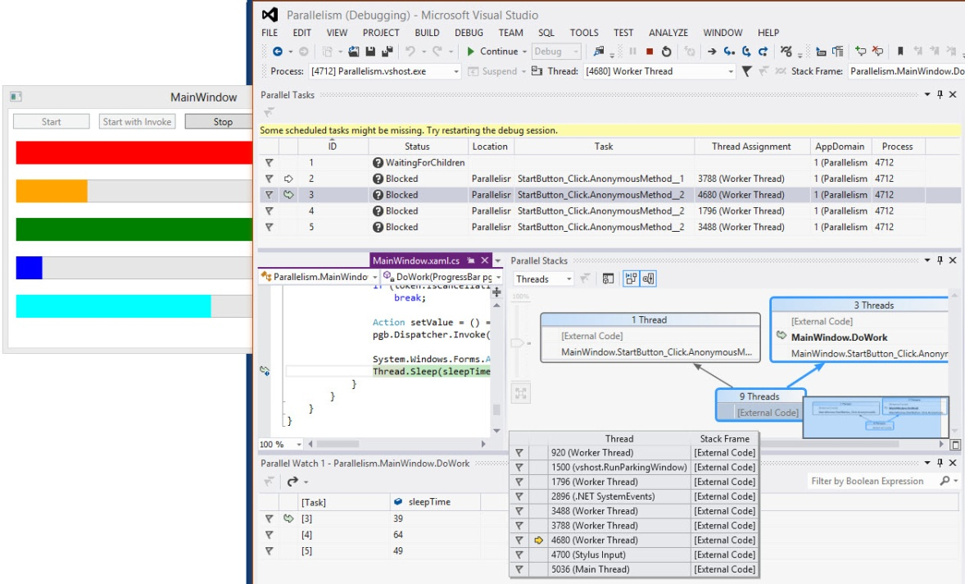
Debugging Parallel Tasks
Multitasking and Parallel Programming
Three Visual Studio debug windows can help with debugging parallel tasks
Debug | Windows
Parallel Tasks
Parallel Stacks
Parallel Watch

Slide 21
Canceling a Task
Multitasking and Parallel Programming
You can access a model for cancellation of operations
With two classes, CancellationTokenSource and CancellationToken
And an exception, OperationCanceledException

Slide 22
Canceling a Task
Multitasking and Parallel Programming
The originator creates a CancellationTokenSource object and passes its token to the tasks it creates
Tasks can pass the token to children tasks
The originator can ask for operation cancelation by calling the Cancel method on the CancellationTokenSource
Operations should monitor the IsCancellationRequested property by polling
A canceled operation can either return to terminate, or call ThrowIfCancellationRequested to throw an OperationCanceledException

Slide 23
var tokenSource = new CancellationTokenSource();
var token = tokenSource.Token;
var task = Task.Factory.StartNew(() => {
while (someCondition)
{
// Do some work
token.ThrowIfCancellationRequested();
}
}, token);
if (someOtherCondition)
tokenSource.Cancel();
try
{
task.Wait();
}
catch (AggregateException e)
{
if (e.InnerException is OperationCanceledException)
// Process exception
}
Will throw an exception if cancellation was requested. Does nothing otherwise
The token is passed as second parameter to the StartNew method
Canceling a Task
Ask for cancellation
Wait for the task to complete
Catches multiple exceptions in tasks
Indicates cancellation

Slide 24


Questions?

Slide 25

plinq
Parallel and Asynchronous Computing

Slide 26
Introduction
PLINQ
Parallel implementation of LINQ
Add the AsParallel() extension method to the source
Other options exist
AsOrdered()—to preserve the source order
AsSequential()— Run the rest of query in non-parallel mode
WithDegreeOfParallelism()
To limit the number of processors used
WithCancellation() — To pass a cancellation token
var q1 = from n in numbers.AsParallel() orderby n select n;

Slide 27
Introduction
PLINQ
Using PLINQ can make queries run faster
Can also slow them because parallel management overhead
Use PLINQ when queries involve complex, time-consuming operations

Slide 28
Enumerating a PLINQ Query
PLINQ
Sequential LINQ query execution deferred until enumerated
In a ForEach loop
Or put into a list with ToList()
Each item in the result set is then executed in sequence

Slide 29
Enumerating a PLINQ Query
PLINQ
ForAll can avoid merge phase, leading to a faster execution time
Can use the ConcurrentBag collection
Generic thread-safe unordered collection
PLINQ query
ForEach loop
PLINQ query
ForAll loop
Task
Task
Task
Task
Task
Task
Task
Bottleneck
Notes:
Illustrated in demo – see next slide

Slide 30
Concurrent Collections
PLINQ
Concurrent collections are thread-safe
Include their own locking mechanism
In the System.Collections.Concurrent namespace
Class | Description
ConcurrentBag<T> | Thread-safe bag
ConcurrentDictionary<Tkey, Tvalue> | Concurrent dictionary
BlockingCollection<T> | For passing data between producers and consumers
ConcurrentQueue<T> | FIFO queue
ConcurrentStack<T> | LIFO stack
Notes:
FIFO = first-in, first-out
LIFO = last-in, first-out

Slide 31
Questions?

Slide 32

Exercise
PLINQ
Copy paste this code:
List<List<int>> lli = new List<List<int>>();
Random r = new Random();
for(int i = 0; i < 2000; i++) {
List<int> li = new List<int>();
for(int j = 0; j < 2000; j++) {
li.Add(r.Next(20, 300));
}
lli.Add(li);
}

Slide 33
Exercise
PLINQ
Use LINQ to compute factorial of each number in these lists with this function:
Note that results aren’t important for this exercise.
No need for them to be stored
lli.ForEach(n => n.ForEach( el => Enumerable.Range(1, el) .Aggregate((a, b) => a * b)));

Slide 34
Exercise
PLINQ
Modify the previous function to compute with PLINQ
Check on MSDN the StopWatch class to output elaspsed milliseconds for these two functions

Slide 35
Asynchronous calls
Parallel and Asynchronous Computing

Slide 36
Asynchronous Programming Patterns
Asynchronous Calls
Asynchronous Programming Model (APM)
Begin and End methods; e.g., BeginWrite and EndWrite
Uses the IAsyncResult interface
Event-based Asynchronous Pattern (EAP)
By convention, methods with Async in it
Uses events, event handler delegate types, EventArgs derived types

Slide 37
Asynchronous Programming Patterns
Asynchronous Calls
Task-based Asynchronous Pattern (TAP)
With the Task and Task<TResult> classes from the TPL
Introduced in .NET 4
Simplified in .NET 4.5 with async and await keywords
Recommended for implementing asynchronous calls

Slide 38
Asynchronous Methods in .NET Classes
Asynchronous Calls
Many classes have methods that implement the TAP
Generally with the Async suffix
When called, a task is created to execute the method code
Here are some examples:
Class | Some asynchronous methods
HttpClient | GetAsync, PostAsync
StreamReader | ReadAsync, ReadLineAsync, ReadToEndAsync,
StreamWriter | WriteAsync, WriteLineAsync
Socket | AcceptAsync, SendAsync

Slide 39
Asynchronous Methods in .NET Classes
Asynchronous Calls
These methods return a Task<return-type>
return-type: Type of data normally returned by method

Slide 40
Async and Await
Asynchronous Calls
Waiting for an asynchronous task to finish can be done with the await keyword
The method where await is used must be declared with the async keyword
async void AsyncRead(string fileName)
{
var sr = new StreamReader(fileName);
var task = sr.ReadToEndAsync();
//... Can do something else
var text = await task;
}

Slide 41
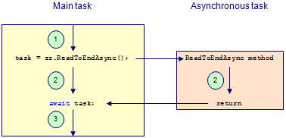
Execution Flow of an Asynchronous Call
Asynchronous Calls
The asynchronous method runs in parallel with the main method

Slide 42
Asynchronous Method Return Type
Asynchronous Calls
An asynchronous method can return:
void if it doesn’t return data
Task or Task<T> where T is the type of the data the method returns

Slide 43
Asynchronous Method Return Type
Asynchronous Calls
Declared as Task<string>
async Task<string> Read(string fileName)
{
var sr = new StreamReader(fileName);
string fileContent = await sr.ReadToEndAsync();
return fileContent;
}
Returns a string

Slide 44
Calling an Asynchronous Method
Asynchronous Calls
Asynchronous method can be called without await
Returned value is Task or Task<T> object
Task<string>
var task = sr.ReadToEndAsync();
//... Can do something else
var text = await task;
string

Slide 45
Calling an Asynchronous Method
Asynchronous Calls
Or it can be called with the await keyword
The returned type is the generic declared type
Calling method must be declared with async
var text = await sr.ReadToEndAsync();
string

Slide 46
Custom Asynchronous Tasks
Asynchronous Calls
Custom asynchronous task should delegate its work to a Task
And return that task
Calling method can use await to wait for the task to end

Slide 47
Custom Asynchronous Tasks
Asynchronous Calls
var square = await SquareAsync(123);
private Task<int> SquareAsync(int value)
{
var task = new Task<int>(() =>
{
Thread.Sleep(3000);
return value * value;
});
task.Start();
return task;
}

Slide 48
Running Multiple Asynchronous Tasks
Asynchronous Calls
To run multiple asynchronous tasks
Create an array of tasks
Pass the array to the static/shared WhenAll method of the Task class
Return value is an array of the returned values of each task
Can use WhenAny to return when one of tasks has finished
Asynchronous tasks can be canceled
With the CancellationToken pattern

Slide 49
Questions?

Slide 50
Quiz 1/3
What are the preferred methods for running threads in .NET 4?
_________________________________________________________
Write the code to run two tasks in parallel in C# or VB:
_________________________________________________________

Slide 51
Quiz 2/3
How would you run a loop using the TPL?
_________________________
Which extension method transforms a LINQ query into a PLINQ query?
___________________________________________________

Slide 52
Quiz 3/3
What is the return data type of an async method?
_________________________

Slide 53

The End
Parallel and Asynchronous Computing
That’s all folks!

